Slide 1
Voluntr
Matthew Osborne, Aleksander Fritz, Austin Auger, Brett Seeberger, Michael Tillett

Slide 2
Rails - Models
Model describes objects as they will be stored in DB
> rails g model RequestUser email:string tel_num:string fax_num:string [...]
class CreateRequestUsers < ActiveRecord::Migration[5.0] def change create_table :request_users do |t| t.string :email t.string :password_digest t.string :display_name t.string :tel_num t.string :fax_num t.string :website_address t.text :about_me end end end

Slide 3
Rails - Controllers
> rails g controller RequestUsers new show
class RequestUsersController < ApplicationController def new @request_user = RequestUser.new End
[...]
def show @request_user = RequestUser.find(params[:id]) End
[...] end

Slide 4
Rails - Views
Use ERB (Embedded RuBy) to process pages
Evaluating a statement.
<% if @volunteer_user.availability %> ... <% end %>
Evaluating a statement and presenting
<% if (!@volunteer_user.availability.wed_en) %> <%= "Unavailable" %> <% else %> <%= @volunteer_user.availability.wed_en.strftime("%I:%M %p") %> <% end %>

Slide 5
Rails - Helpers
module RequestSessionsHelper
[...] def current_request_user if (request_user_id = session[:request_user_id]) @current_request_user ||= RequestUser.find_by(id: session[:request_user_id]) elsif (request_user_id = cookies.signed[:request_user_id]) request_user = RequestUser.find_by(id: request_user_id) if request_user && request_user.authenticated?(cookies[:remember_token]) request_log_in request_user @current_request_user = request_user end end end
[...]
end

Slide 6
What is Voluntr ?
Bringing together people
Volunteering
Organizing
Evaluations

Slide 7
Why Voluntr?
Benefits for Volunteers
One place for finding Organizations
Ability to Search Organizations and Events
Ability to follow Orgs. of Interest
Able to filter quality of work using scoring system
Able to rate Orgs.
Able to get notifications about new Events/Jobs
Able to be listed, so Organizations can find you
Benefits for Higher scores

Slide 8
Why Voluntr? (cont.)
Benefits for Organizations
Ability to Search and Find Volunteers Based on predefined skillsets
Ability to create Events and Jobs for those Events
Volunteers able to search and find them
Able to show interest in Volunteers
Able to filter through Volunteers using the scoring system***

Slide 9
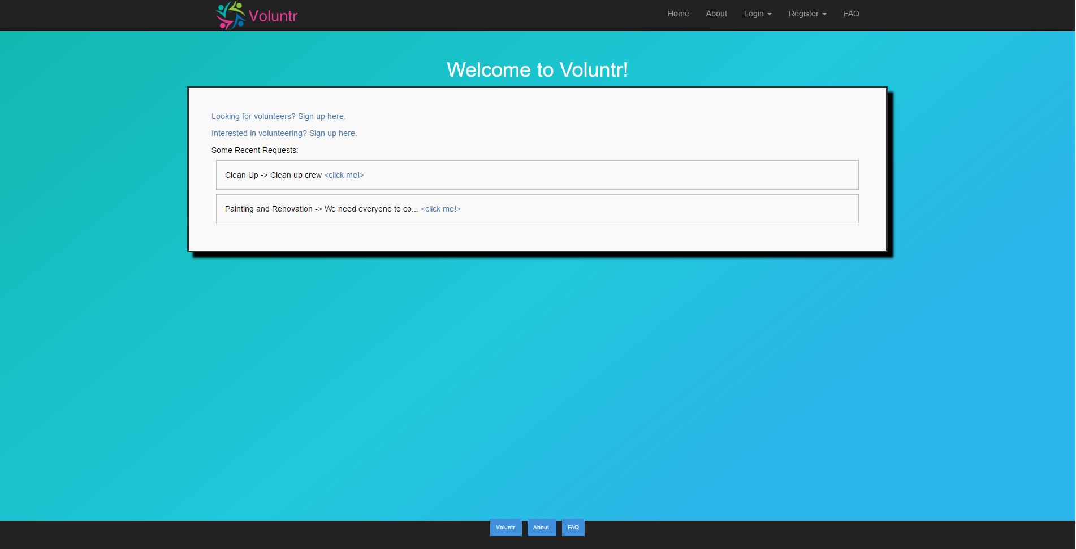

Slide 10
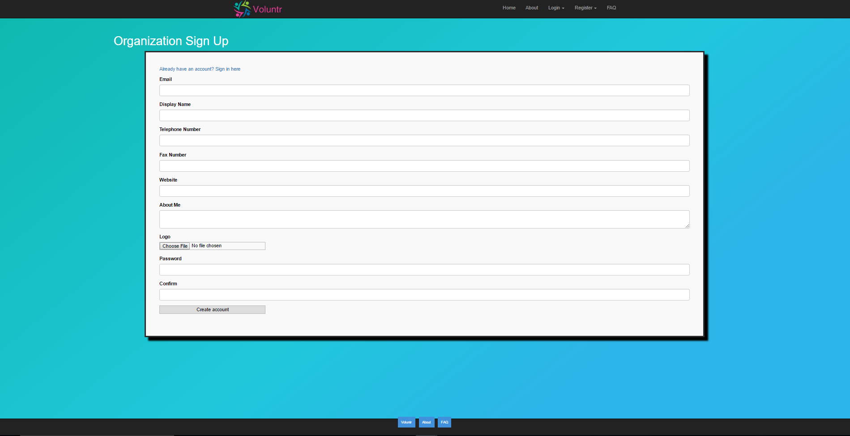

Slide 11
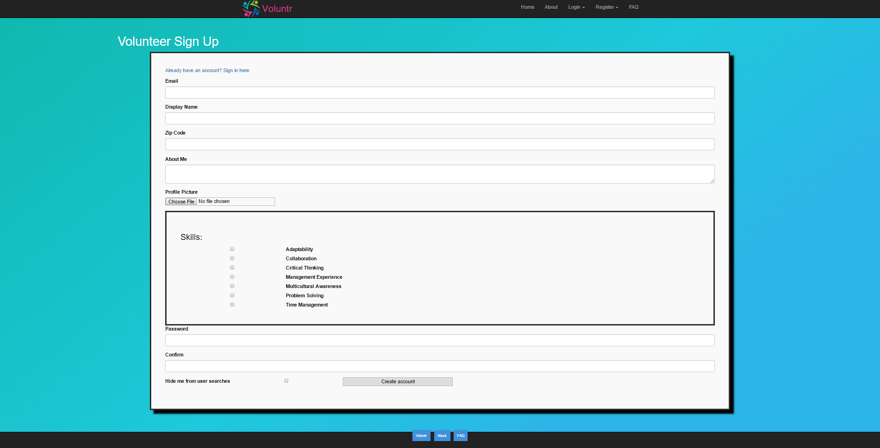

Slide 12
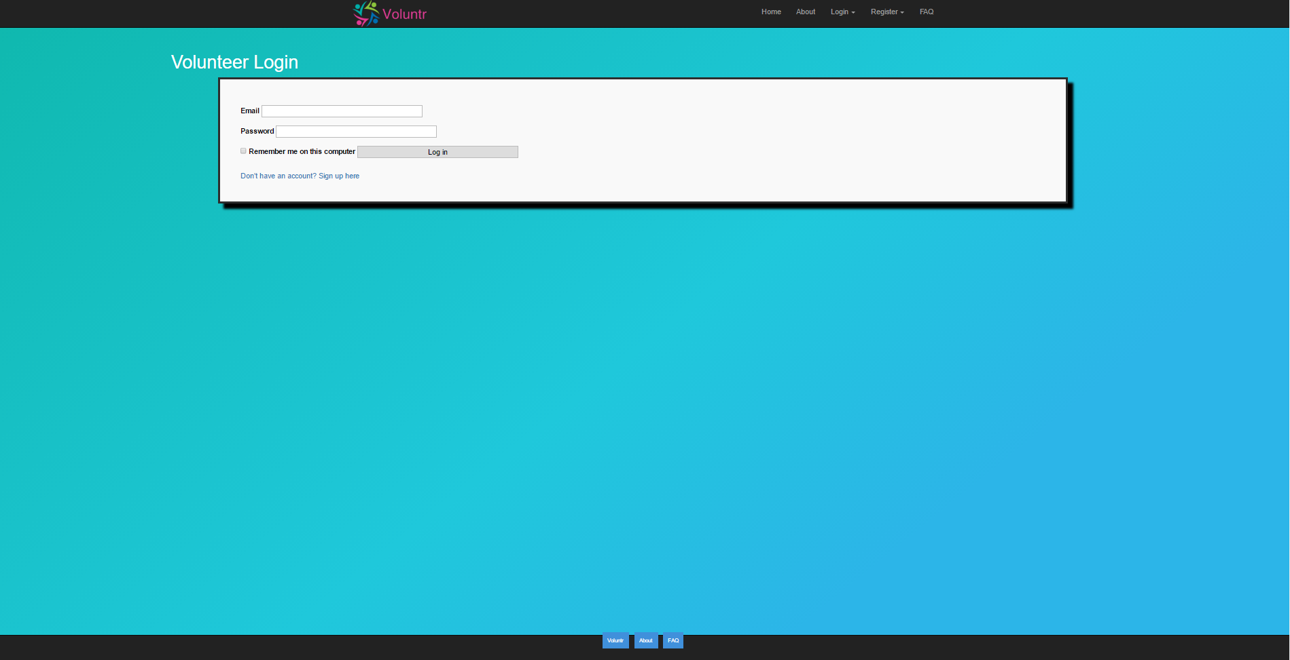

Slide 13
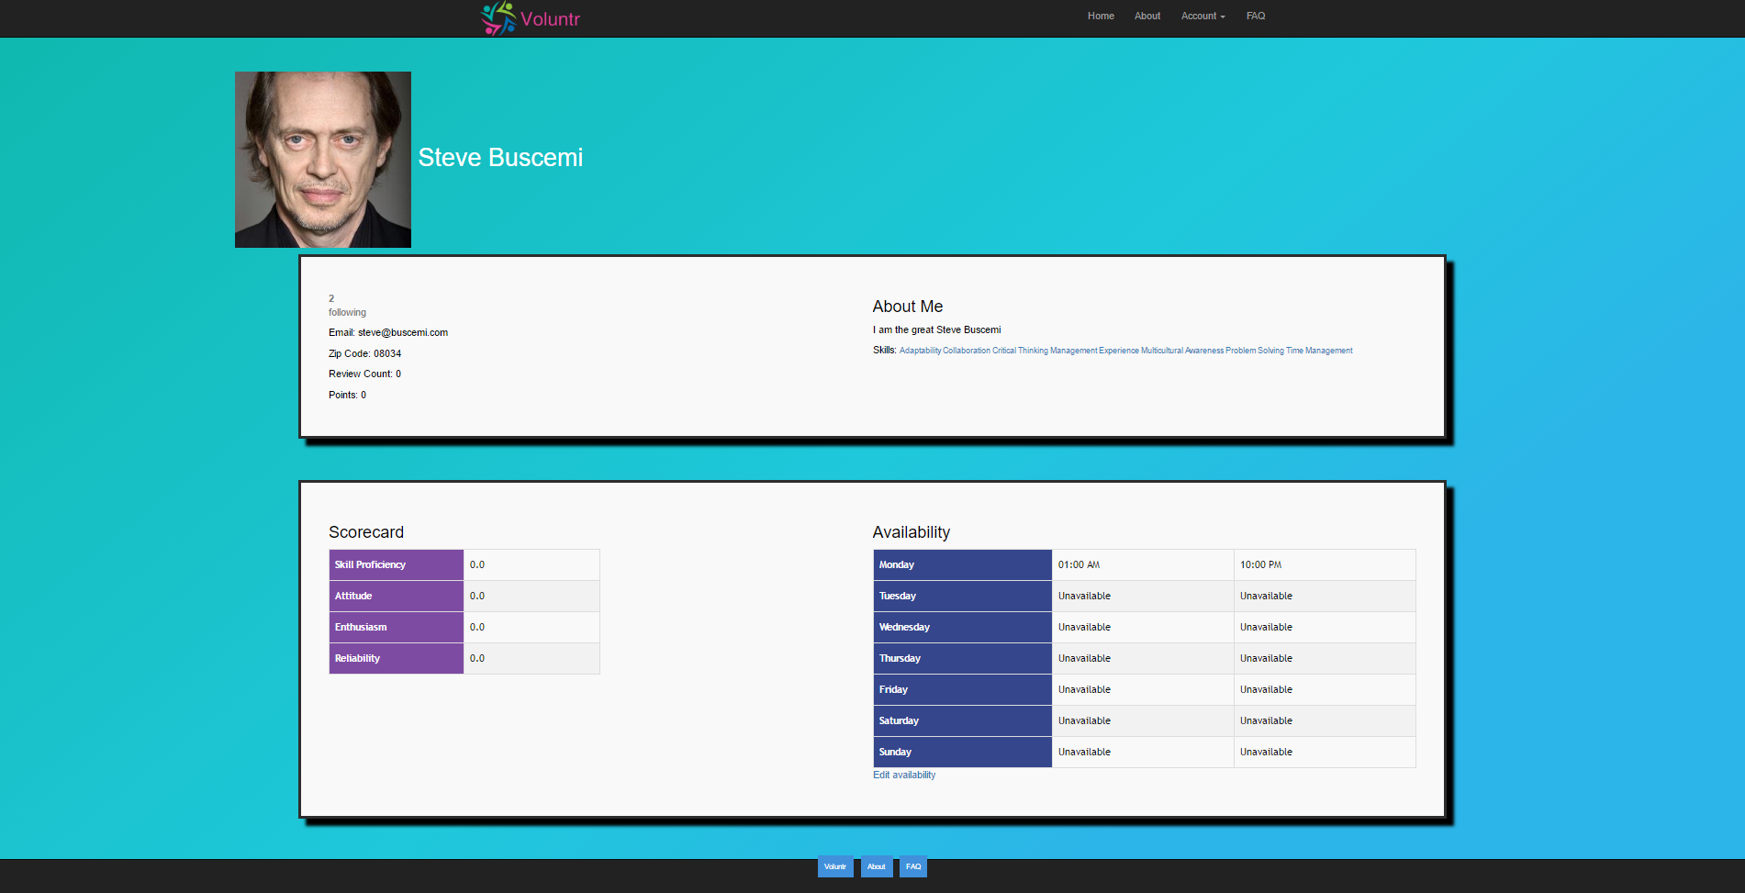

Slide 14
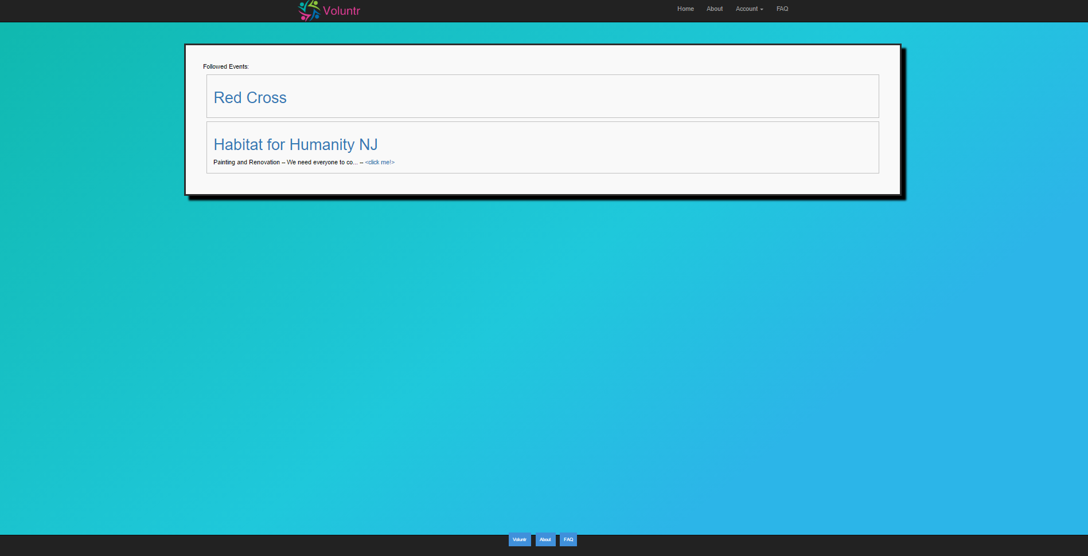

Slide 15
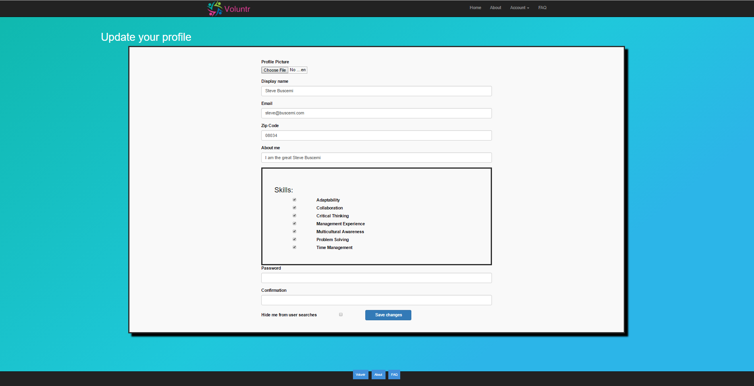

Slide 16
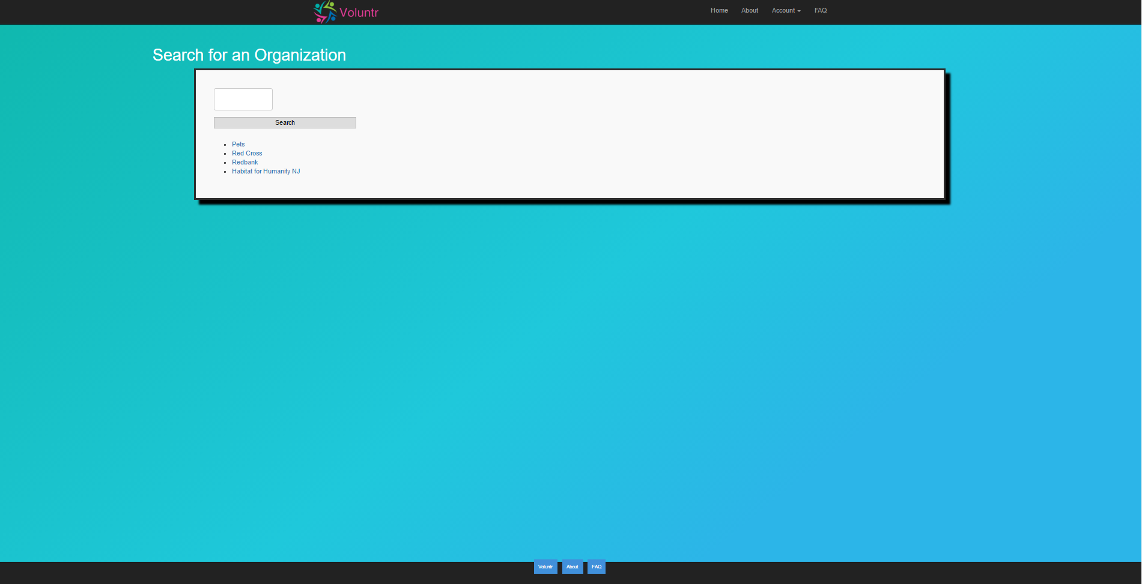

Slide 17
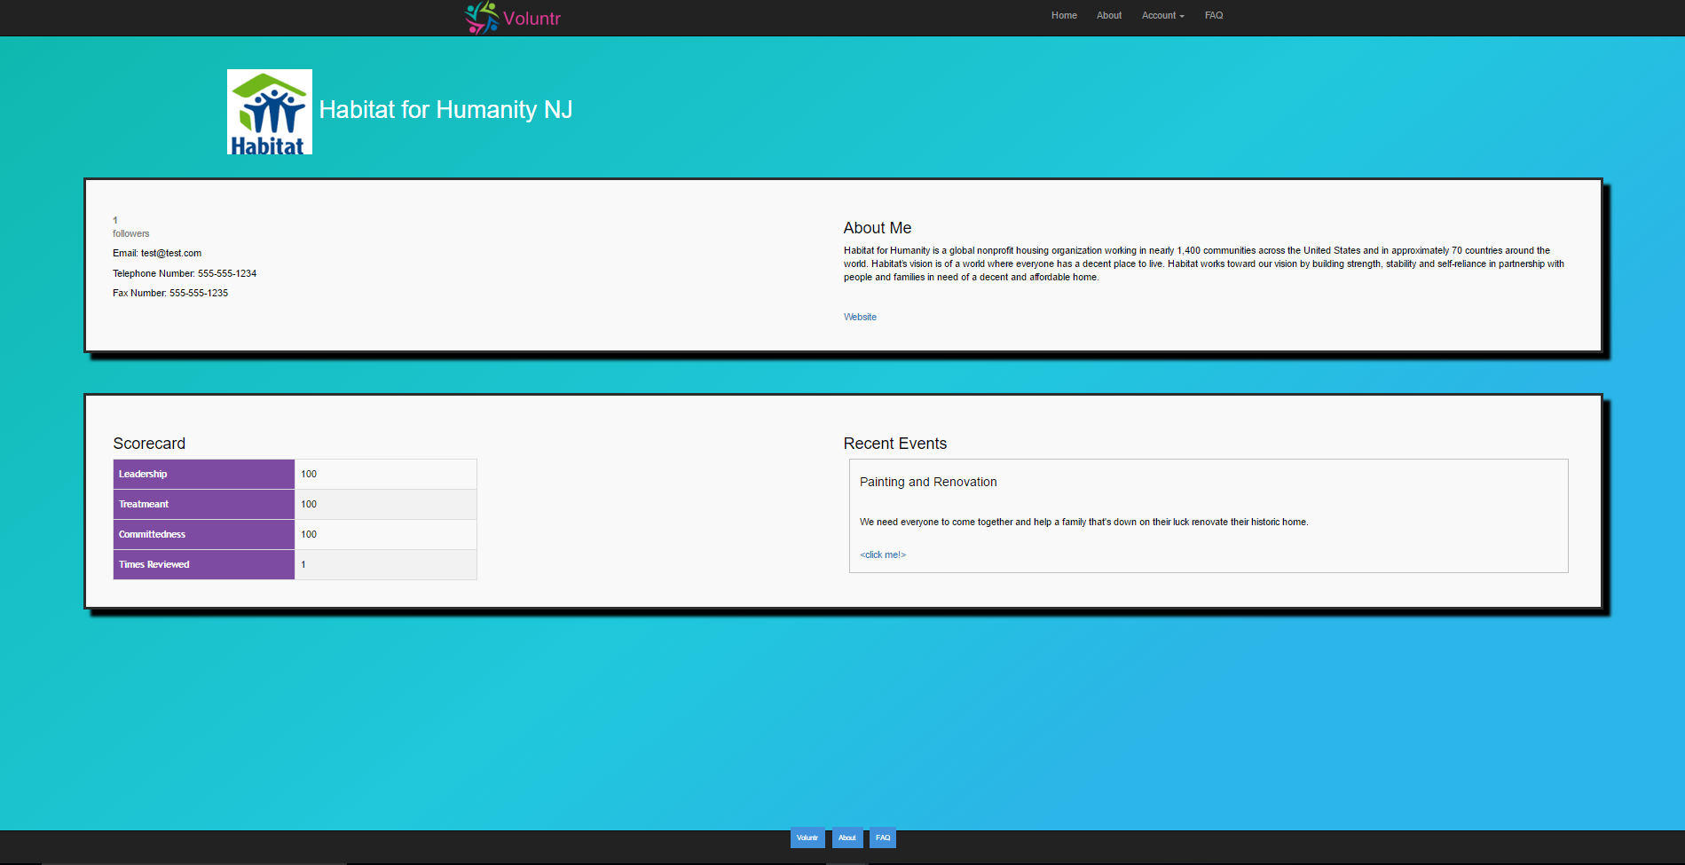

Slide 18
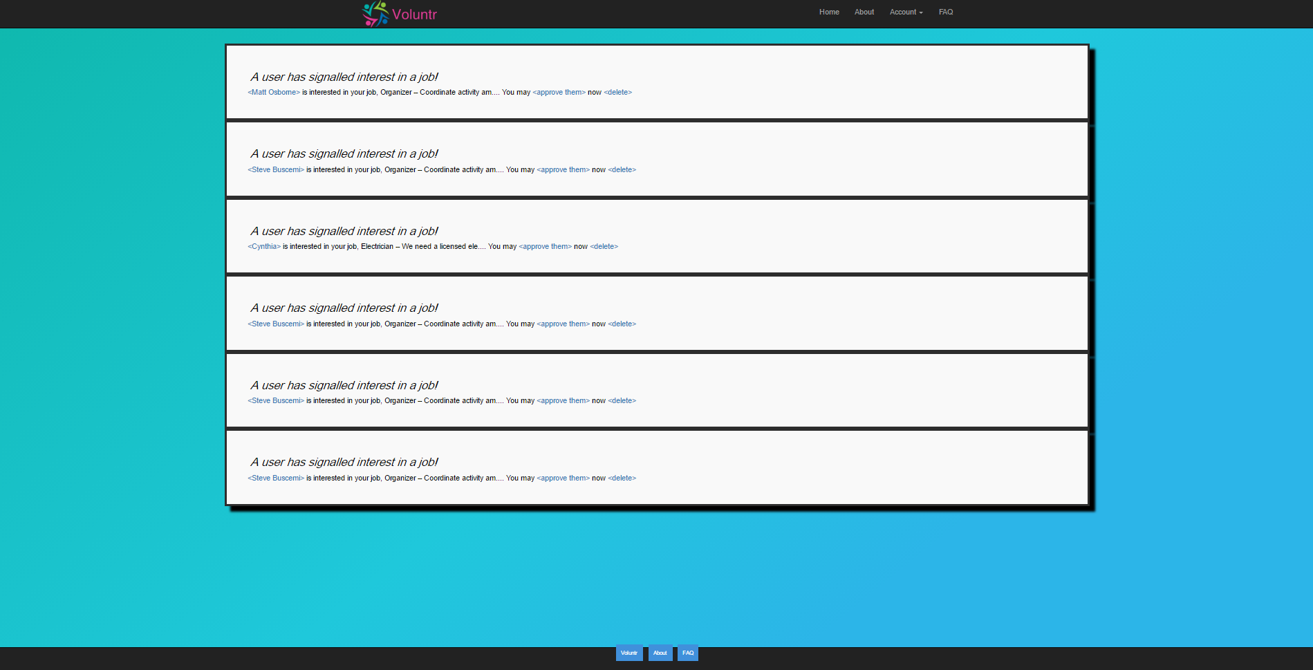

Slide 19
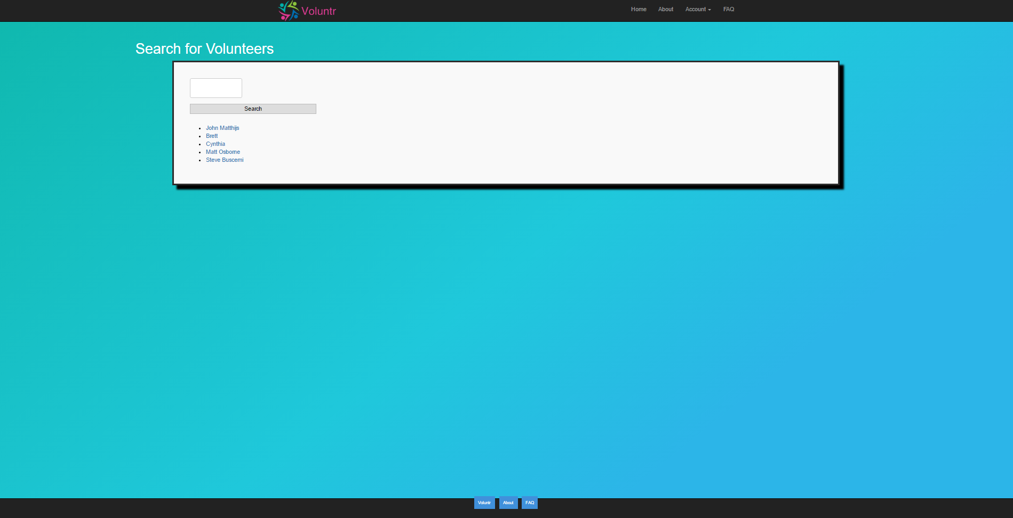

Slide 20
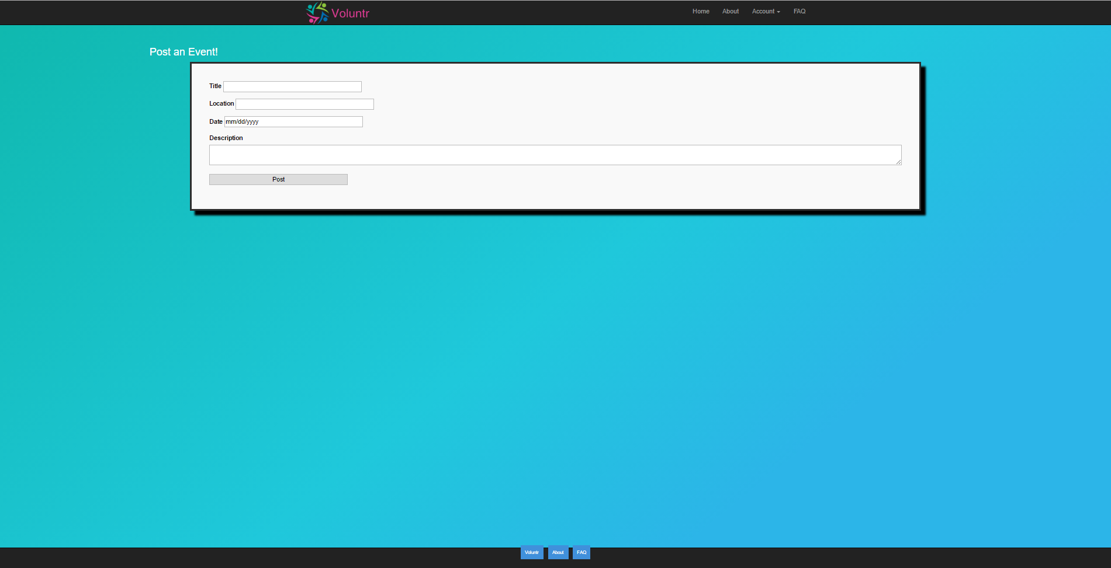

Slide 21
Try it out for yourself!
goo.gl/xrpehQ

